Slide 1

Installing Anaconda and Geopandas
September 9, 2019
Mike Babb, Ph.C.
Center for Social Science Computation and Research
Department of Geography, UW

Slide 2
Installing Anaconda
If you need to install Anaconda
https://www.anaconda.com/distribution/
Make sure to select the Python 3.764-bit, graphical installer version
Download and install, accept all defaults.
It will take several minutes

Slide 3
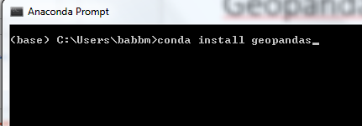
Installing Geopandas Part 1
Additional packaged needed for spatial data analysis
Installed through the Anaconda Prompt
On a Windows PC: Start Menu → Anaconda3 → Anaconda Prompt
Once the prompt opens, enter the following:
conda install geopandas

Slide 4
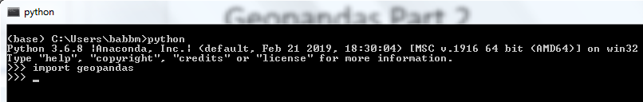
Installing Geopandas Part 2
The package will take several minutes to install
Once complete, enter the following
python (press enter)
import geopandas (press enter)
if nothing happens, geopandas was installed successfully
type and enter exit()
type and enter exit

